Slide 1
Data Model Exercise
Neti Sheth
Chukwuebeka Ezema
Josh Stamper
Yagna Venkitasamy

Slide 2
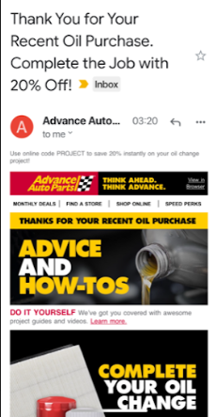
User Stories
As a customer, I want to receive product promotions based on my purchase history so that I can save money.
As a vendor, I want to send product promotions and recommendations to the customer based on their purchase history so that I can improve customer loyalty.

Slide 3
Entities and Attributes

Slide 4
Collaborative Filtering
First, we identify the customer and product purchased to start with
Next, we identify the other customers who have also purchased the same product
Then we find the other products which those other customers have also purchased
Finally, we direct the current customer to the top products from those other products, prioritized by the number of times they were purchased.
Notes:
Collaborative Filtering, - doesn’t need anything else except users’ historical preference on a set of items. Because it’s based on historical data, the core assumption here is that the users who have agreed in the past tend to also agree in the future.

Slide 5
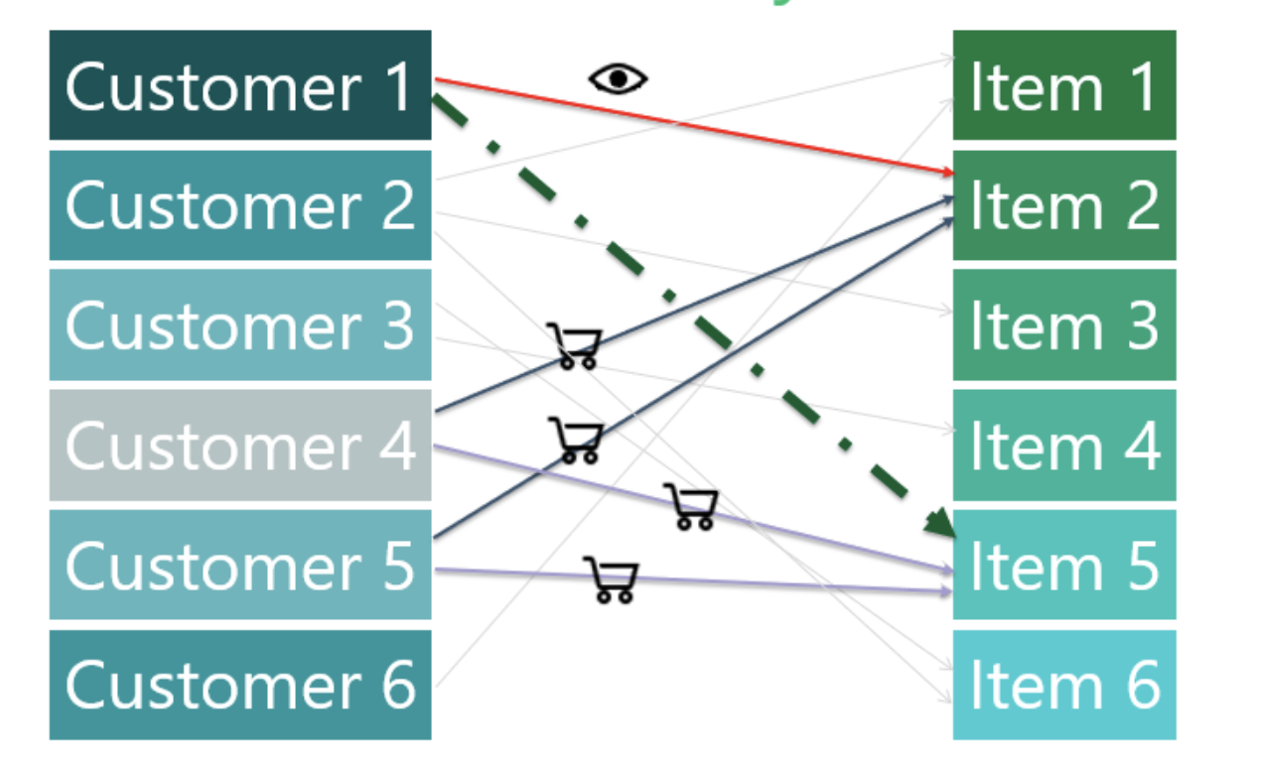

Slide 6
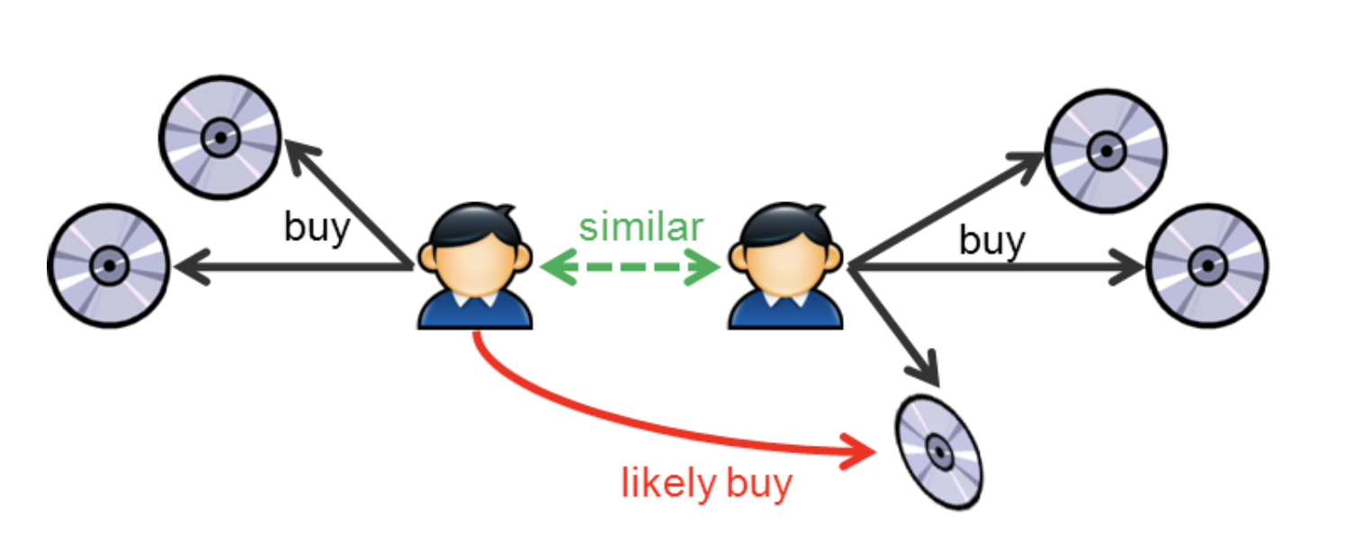
User Based Collaborative Filtering
Notes:
The process is to calculate the similarities between target user i and all other users, select the top X similar users, and take the weighted average of ratings from these X users with similarities as weights.
Basically, the idea is to find the most similar users to your target user (nearest neighbors) and weight their ratings of an item as the prediction of the rating of this item for target user. Without knowing anything about items and users themselves, we think two users are similar when they give the same item similar ratings .

Slide 7
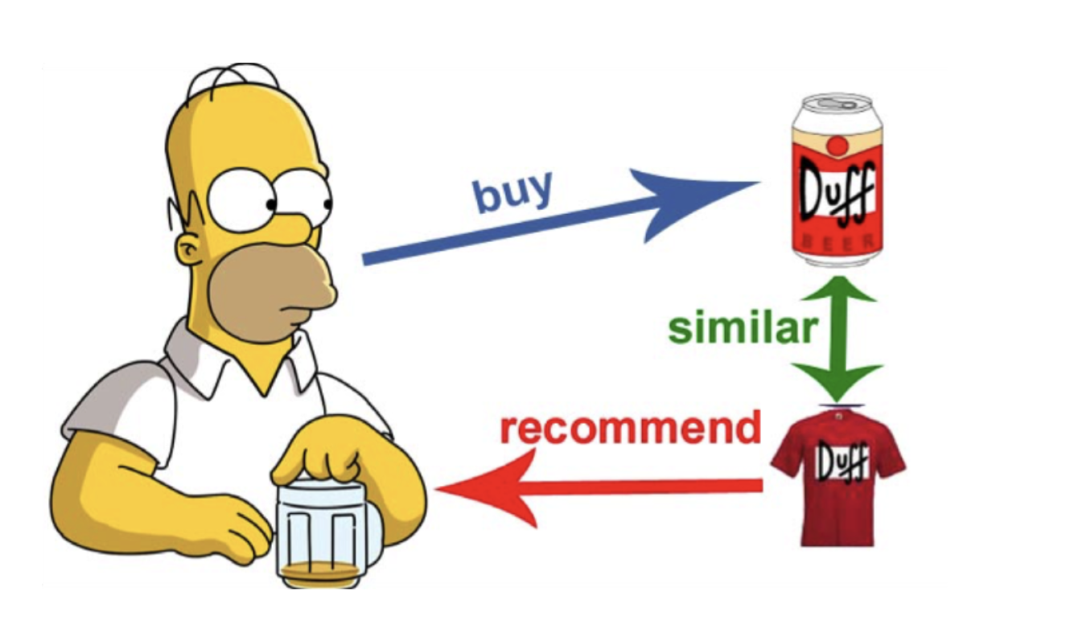
Item Based Collaborative Filtering
Notes:
Item-based CF - we say two items are similar when they received similar ratings from a same user. Then, we will make prediction for a target user on an item by calculating weighted average of ratings on most X similar items from this user

Slide 8
Advantages of Item-Based CF
Computing item-based collaboration filter has more benefit than computing user to user similarity
Number of items typically smaller than number of users
While user's taste will change over time and hence the similarity matrix need to be updated more frequent, item to item similarity tends to be more stable and requires less update

Slide 9
CF - SQL implementation example
Goal: Recommend a product item to User1.
What will the recommendation be?
Item Z? (there are two people who liked Z in conjunction with liking C )
Item C? (User2 has a more similar interest-pattern)

Slide 10
Insert the test data
Join the test data onto itself by item_id, and create a temporary table to hold each cust_id and the number of items it has in common with the target cust_id.
We can see that cust_id 2 has 3 items in common with cust_id 1, but cust_id 3 and cust_id 4 only have 1 each.

Slide 11
Next, select all the items that the customers in the temporary table have that do not match the target cust_id’s items, and arrange these by rank.
Same items might appear in different customer’s lists, so we sum the rankings for each item so that common items get a higher ranking.
Item Z appeared in two customers lists, and so was ranked above X,Y,Q,W which only appeared in one customer’s list.
Item D did best because it appeared in cust_id 2's list, which had 3 items in common with target cust_id 1.

Slide 12
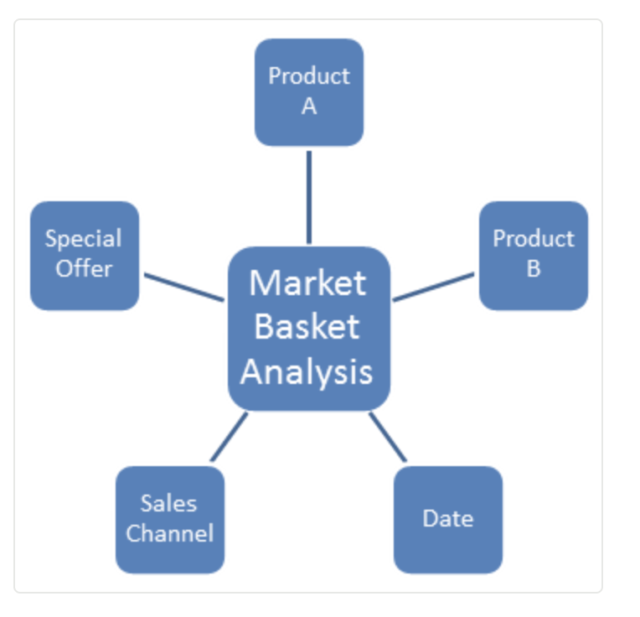
Market Basket Analysis
Market-basket analysis means, in its simplest implementation, finding which products tend to get purchased together, in the same basket.

Slide 13
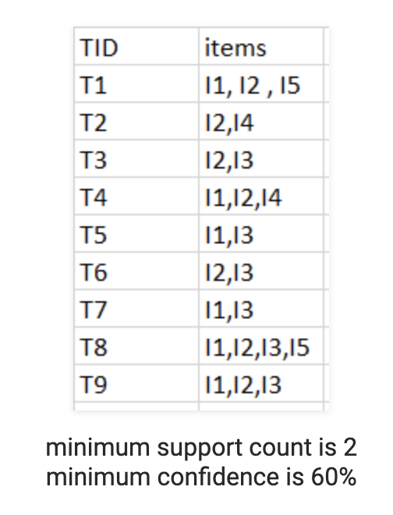
Goal: Consider the following dataset and find frequent item sets and generate association rules for them.

Slide 14
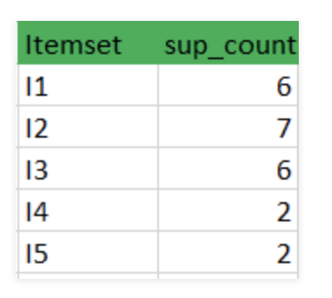
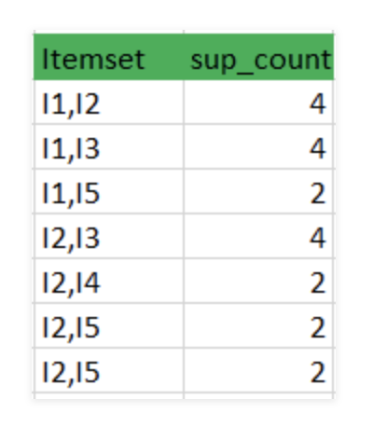
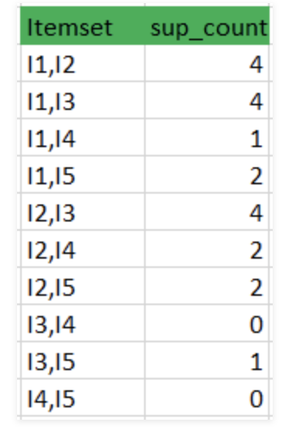
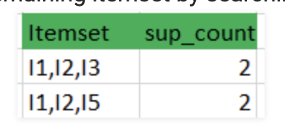

Slide 15
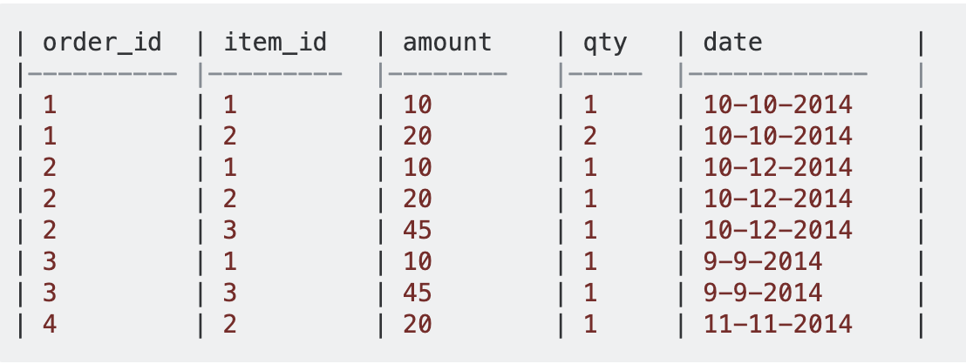
Market Basket – SQL Implementation Example
Goal: Get a list of items that most frequently occur together for recommendation.
Transactions/orders table:

Slide 16
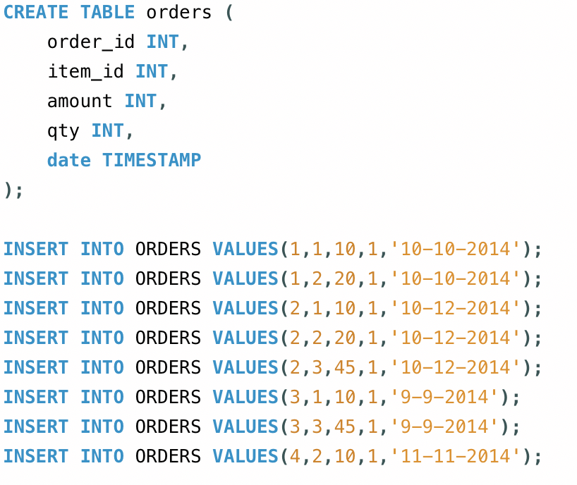
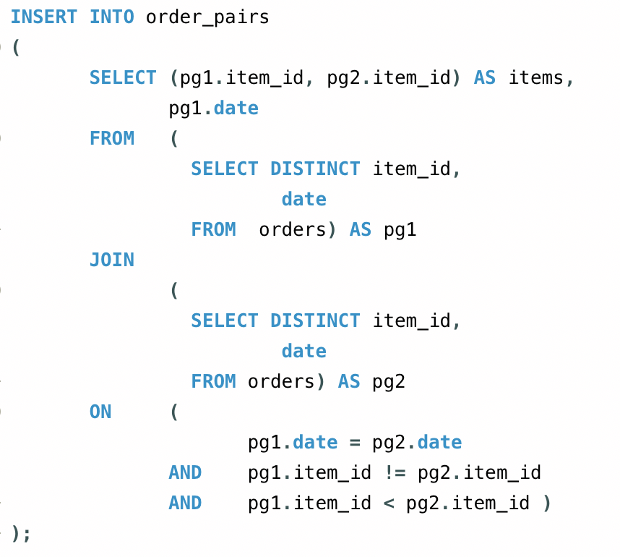

Slide 17
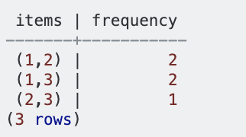
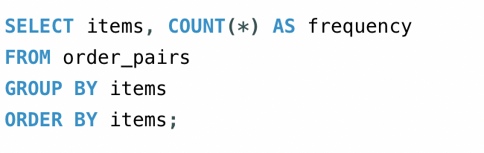

Slide 18
Scenario Phases
Descriptive: Understanding data and transactions
Predictive: Using some ML, predict the next purchase
Prescriptive: Sending the recommendation with added incentive

Slide 19
References
https://towardsdatascience.com/intro-to-recommender-system-collaborative-filtering-64a238194a26
https://blogs.msdn.microsoft.com/sqlcat/2017/04/21/build-a-recommendation-system-with-the-support-for-graph-data-in-sql-server-2017-and-azure-sql-db/
https://medium.com/data-from-the-trenches/recommendation-engines-101-8fcb6498796
https://rolandholtermann.wordpress.com/2012/05/06/market-basket-analysis-with-sql/

Slide 20
Thank you!

